Slide 1

Energy-Efficient Neuromorphic Computing
MS Project: Final Presentation
Khritish Kumar Behera 17125
Mail: khritish17@iiserb.ac.in
Indian Institute of Science Education and Research [IISER] Bhopal
Advisor: Dr. Kuntal Roy
Mail: kuntal@iiserb.ac.in
Date: 27-04-2022

Slide 2
Content
Recap
Motivation
Artificial Neural Network
Character Recognition Model
Spintronics
Magnetic Anisotropy
Magneto-elastic Anisotropy
Perpendicular Anisotropy
Giant Magneto-Resistance
Tunneling Magneto-Resistance
Multiferroic Composites
Ferromagnetic Resonance
Experimental
Ferromagnetic Resonance Setup
Sputtering Plan
MgO/CoFeB MOKE Result
Neuromorphic hardware
Future Works

Slide 3
Content
Recap
Motivation
Artificial Neural Network
Character Recognition Model
Spintronics
Magnetic Anisotropy
Magneto-elastic Anisotropy
Perpendicular Anisotropy
Giant Magneto-Resistance
Tunneling Magneto-Resistance
Multiferroic Composites
Ferromagnetic Resonance
Experimental
Ferromagnetic Resonance Setup
Sputtering Plan
MgO/CoFeB MOKE Result
Neuromorphic hardware
Future Works

Slide 4
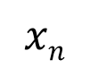
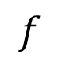
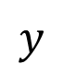
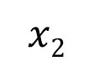
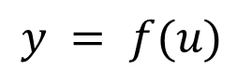
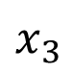
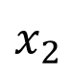
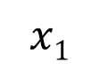
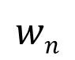

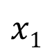
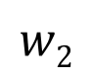
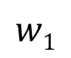
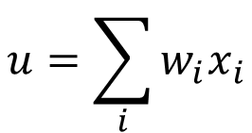
Energy-Efficient Neuromorphic Computing
Neuromorphic Computing is usually performed on traditional transistor based devices
$$u=\sum_{i}{w_{i}x_{i}}$$
$$x1$$
$$w1$$
$$y = f(u)$$
$$x2$$
$$w2$$
$$Σ$$
.
.
.
$$wn$$
Spintronic devices can be more energy-efficient than traditional transistors
$$f$$
$$xn$$
$$y$$
Piezoelectric
$$x1$$
Spintronic devices encapsulates
Weight, Sum and Threshold function
$$x_{2}$$
$$x_{3}$$
Neuron
Read
Insulator
Magnetostrictive
Write
Non-Boolean Computing

Slide 5
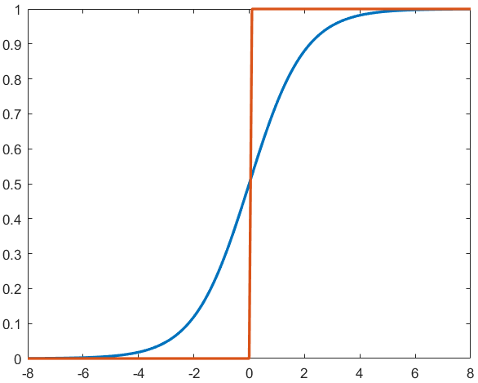
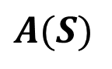
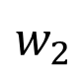
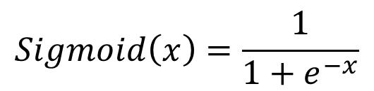

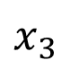

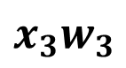
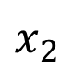
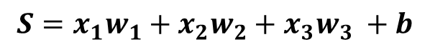
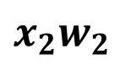
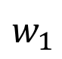
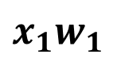
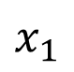
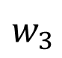
ANN: Sequential Process
Summation
Weight, strength of the edge
$$w_{1}$$
$$x_{1}$$
b
$$x_{1}w_{1}$$
b
$$w_{2}$$
$$x_{2}$$
$$Σ$$
$$x_{2}w_{2}$$
$$Σ$$
$$S=x_{1}w_{1}+x_{2}w_{2}+x_{3}w_{3} +b$$
$$w_{3}$$
$$x_{3}$$
$$x_{3}w_{3}$$
Bias, sets the activation function
$$Sigmoid\left(x\right)=\frac{1}{1+e^{−x}}$$
Activation
$$A(S)$$
Inspired from biological neuron
Non-linear function

Slide 6
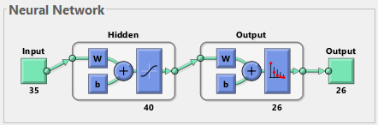
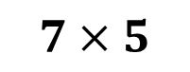
Artificial Neural Network: Neural Architecture
$$7×5$$
Input
35 (7x5)-bit word of the test character
Output
26-bit word suggesting the character
Input
A: 01110 10001 10001 11111
10001 10001 10001
Output
A: 10000000000000000000000000
B: 01000000000000000000000000

Slide 7
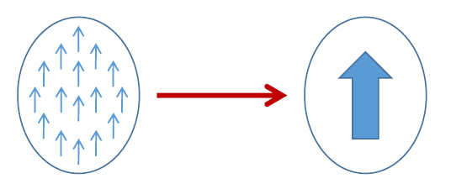
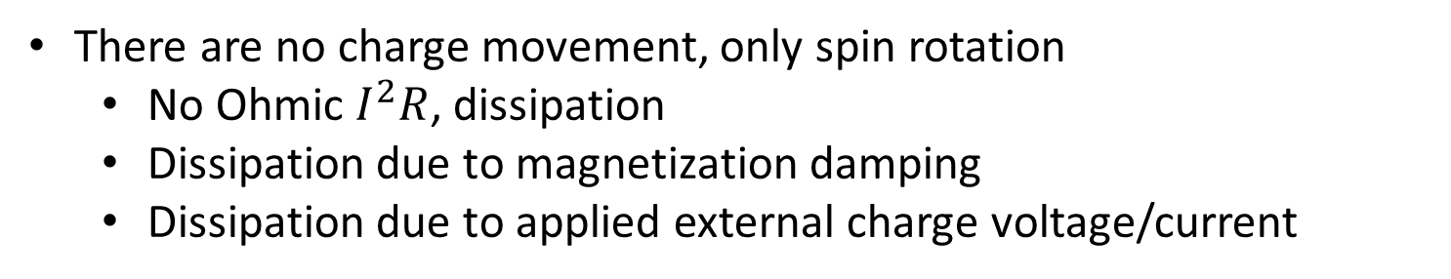

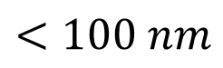
Spintronics: Spin-Electronics
UP
DOWN
0
1
Spin
Bits
Spin
$$e^{−}$$
Charge
Electron
Spintronic devices, advantages over transistor
non-volatile
endurable
There are no charge movement, only spin rotation
No Ohmic $I^{2}R$, dissipation
Dissipation due to magnetization damping
Dissipation due to applied external charge voltage/current
Electron Beam Lithography
$$<100 nm$$

Slide 8
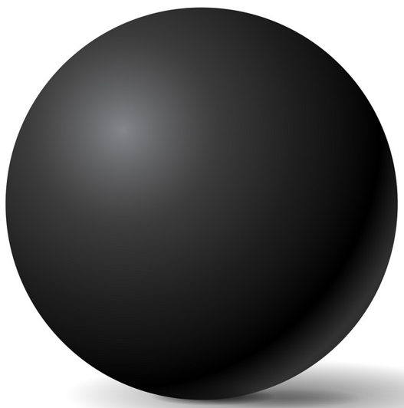
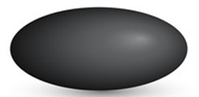


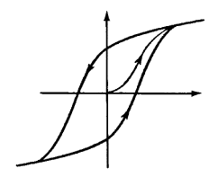
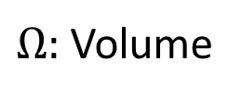
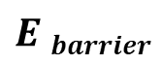
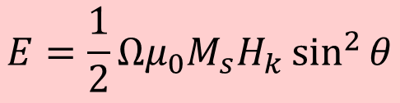
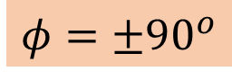
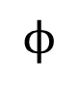
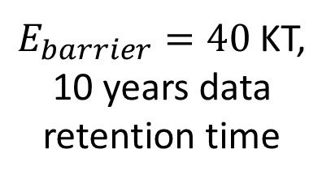
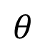
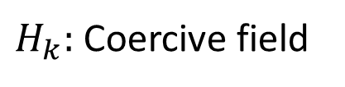
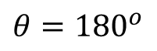
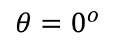
Magnetic Anisotropy
CoFeB
Sphere
Ellipsoid
Elliptical Cylinder
No anisotropy
Difficult to fabricate
In-plane
Shape anisotropy
x
Magnetization
30-80 KT at 300 K
$$E=\frac{1}{2}Ωμ_{0}M_{s}H_{k}\sin^{2}{θ}$$
$$ϕ$$
$$θ$$
$$E barrier$$
z
y
$$φ=±90^{o}$$
$H_{k}:$Coercive field
M
$Ω:$ Volume
$E_{barrier}=40$ KT,
10 years data retention time
H
$$θ={180}^{o}$$
$$θ=0^{o}$$
H_{k}

Slide 9
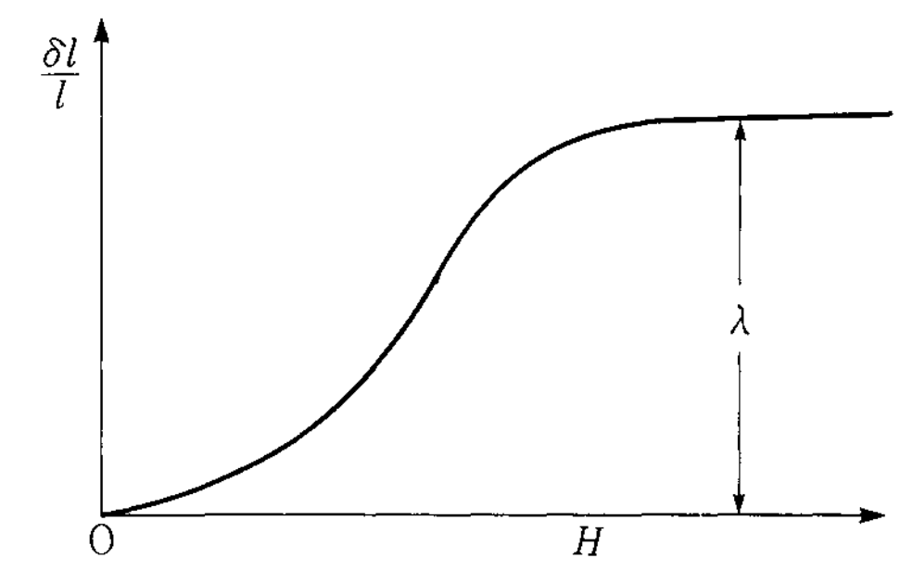
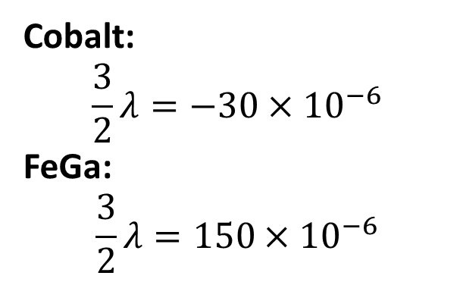
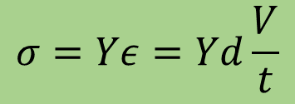
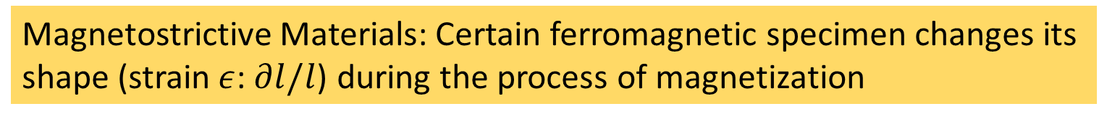
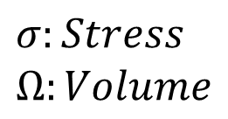
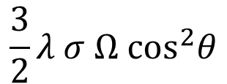

Magneto-elastic anisotropy
Magnetostrictive Materials: Certain ferromagnetic specimen changes its shape (strain$ε$:$∂l/l$) during the process of magnetization
Magnetic Anisotropy
Stress Anisotropy
$$σ:Stress$$
$$Ω:Volume$$
$$\frac{3}{2}λ σ Ω \cos^{2}θ$$
$$σ=Yε=Yd\frac{V}{t}$$
Cobalt:
$$\frac{3}{2}λ=−30×{10}^{−6}$$
FeGa:
$$\frac{3}{2}λ=150×{10}^{−6}$$
$λ:$ Magnetostriction Co-efficient

Slide 10






Giant Magneto-Resistance (GMR)
Giant Magneto-Resistance (GMR)
$$GMR=\frac{1−0.55}{0.55}×100≃80\%$$
$$\text{Fe}$$
$$\text{Cr}$$
$$\text{Fe}$$
1988
A. Fert, M.N Baibich et al., Phys. Rev. Lett. 61, 2472 (1988)
P. Grunberg, G. Binash et al., Phys. Rev. B 39, 4828 (1989)
$$GMR[\%]=\frac{R\left(0\right)−R(H)}{R(H)}=\frac{RAP−RP}{R_{P}}×100$$

Slide 11









Tunneling Magneto-Resistance (TMR)
Insulator
e.g., Al₂O₃, MgO
Conductance is proportional to the density of states
N_{L}↑, N_{R}↑, N_{L}↓, N_{R}↓
Left (L)
Right (R)
Left (L)
Right (R)
$$G^{↑↑}∝N_{L}^{↑}{ N}_{R}^{↑}$$
$$G^{↓↓}∝N_{L}^{↓}{ N}_{R}^{↓}$$
$$G^{↓↑}∝N_{L}^{↓}{ N}_{R}^{↑}$$
$$G^{↑↓}∝N_{L}^{↑}{ N}_{R}^{↓}$$
$$EF$$
$$TMR=\frac{GP−G_{AP}}{GAP}$$
Reported 1975 (prior to GMR)
TMR>500% using MgO spacer
$${GP=G}^{↑↑}+ G^{↓↓}$$
$${GAP=G}^{↓↑}+G^{↑↓}$$
Julliere, M. Tunneling between ferromagnetic film. Phys. Lett. A 54, 225-226 (1975)
Moodera, J. S. et al., Phys. Rev. Lett. 74, 3273 (1995)
Mathon, J. et al., Phys. Rev. B 63, 220403 (2001), Butler, W. et al., Phys. Rev. B 63, 054416 (2001)
Yuasa, S. et al., Nature Mater. 3, 868 (2004), Parkin, S. et al., Nature Mater. 3, 862-867 (2004)

Slide 12





Multiferroic Composites
Multiferroic Composite
Multiferroics
Room-temperature operation
Weak magnetoelectric coupling
Magnetostrictive
Piezoelectric
E
Strain
P
$$\boxed{α_{ME}=μ_{0}\frac{∂M}{∂σ}\frac{∂σ}{∂E}}$$
Piezoelectricity
Magnetoelectricity (intrinsic)
$$\boxed{α_{ME}=μ_{0}\frac{∂M}{∂E}}$$
$$ε$$
M
$$σ$$
H
Magnetostriction

Slide 13




Multiferroic composites Voltage vs stress anisotropy
V_{in}
$$ε_{piezo}=d_{piezo}×\left(\frac{V_{in}}{t_{piezo}}\right)$$
$$ε_{mag}≃ε_{piezo}$$
$$σ=Yε_{mag}$$
Magnetostrictive
FeGa
Piezoelectric
t_{piezo}
PMNPT
strain transfer
Choose piezoelectric layer with high de-coefficient
Y: Young’s modulus
Magnetostrictive layer
with high $λ_{s}Y$
$$d=3000 pm/V$$
$$Y=250×{10}^{9} Pa$$
$$t=100 nm$$
$$V=50 mV$$
Stress Anisotropy (for FeGa):
$\frac{3}{2}λ σ Ω \cos^{2}θ$
$=2.4×{10}^{−18} J$ (max.)

Slide 14






Ferromagnetic Resonance
precession
LL Equation
$$\frac{ⅆM}{ⅆt}=−\left|γ\right| M×Heff− \frac{α\left|γ\right|}{M} M×M×Heff$$
damping
Transverse AC field
$$Hy(t)=Hy0{ ⅇ}^{ⅈωt}$$
Negative damping to keep the magnetization rotating
$$ω=\left|γ\right| \sqrt{H_{z}\left(H_{z}+M\right)}$$
In-plane FMR
$ω =\left|γ\right| (Hz−M$)
Perpendicular FMR

Slide 15







Ferromagnetic Resonance
precession
LL Equation
$$\frac{ⅆM}{ⅆt}=−\left|γ\right| M×Heff− \frac{α\left|γ\right|}{M} M×M×Heff$$
damping
Lorentzian
$$Imag(φ_{0})=\frac{−{\left|γ\right|}^{2}MH_{y0}α\left|γ\right|Mω}{{\left(ω_{0}^{2}−ω^{2}\right)}^{2}+{\left(α\left|γ\right|Mω\right)}^{2}}$$
FMR absorption is given by the imaginary part
$$Imag(φ_{0})=\frac{H_{y0}\left|γ\right|}{{\left(αω_{0}\right)}^{2}}$$
At $ω=ω_{0}$
FMR linewidth $ΔH$
Derivative FMR spectra
$$ΔH=\frac{αω_{0}}{\left|γ\right|}$$
Half width at half maximum (HWHM)
$$2 ΔH$$
$$ΔHpy=12.9 Oe$$
15

Slide 16
Content
Recap
Motivation
Artificial Neural Network
Character Recognition Model
Spintronics
Magnetic Anisotropy
Magneto-elastic Anisotropy
Perpendicular Anisotropy
Giant Magneto-Resistance
Tunneling Magneto-Resistance
Multiferroic Composites
Ferromagnetic Resonance
Experimental
Ferromagnetic Resonance Setup
Sputtering Plan
MgO/CoFeB MOKE Result
Neuromorphic hardware
Future Works

Slide 17


Measurement automation with LabView : Electromagnet
Creates a session with electromagnet’s controller for communication
Measures the magnetic field using the gauss probe
Terminates the session and stops further communication
Takes current as input, to set it in the electromagnet
PC with labview is connected to the controller
Gauss probe
The gauss probe and the electromagnet is also connected to the controller
Controller
Electromagnet

Slide 18


Measurement automation with LabView : RF Signal Generator
Creates a session with RF signal generator for communication
Configures the RF signal frequency
Configures the RF signal power level
Configures ON/OFF state of the signal generator
Terminates the session with RF signal generator
PC with labview is connected to the RF signal generator

Slide 19


Measurement automation with LabView : Spectrum Analyzer
Creates a session with spectrum analyzer for communicat-ion
Configures the spectrum analyzer
Fetch the trace from the device
Search position on trace to put marker
Retrieves data from the marker
Terminat-es the session with the device
PC with labview is connected to the Spectrum analyzer

Slide 20


Measurement automation with LabView : Spectrum Analyzer
Creates a session with lock-in amplifier for communicat-ion
Sets the input signal parameters
Configures the internal oscillator for reference signal
Configures the sensitivity
Configures the time constant and low pass filter slope
Terminates the session with lockin
PC with labview is connected to the Lock-in amplifier

Slide 21




Ferromagnetic Resonance: Experimental Setup
Laptop with LabView
Spectrum Analyzer
Signal Generator
Controller
Electromagnet
$$H_{RF}$$
To Spectrum Analyzer
From Signal Generator
$$H_{DC}$$
Coplanar Waveguide

Slide 22

Ferromagnetic Resonance: Experimental Setup
Electromagnet
Sample
To Spectrum Analyzer
From Signal Generator
Co-planar waveguide
S
Spectrum Analyzer
RF Signal Generator
PC with LabView

Slide 23

Ferromagnetic Resonance: Result

Slide 24

Ferromagnetic Resonance: Experimental Setup
Electromagnet
Helmholtz Coil
Sample
From Signal Generator
Schottky diode
Co-planar waveguide
S
Lock-in Amplifier
RF Signal Generator
PC with LabView

Slide 25
Sputtering Plan
FeGa
PMN-PT
PMN-PT
Kapton
Kapton
Thin-film 1
Thin-film 2
PMN-PT thickness
25, 50, 75, 100 nm
PMN-PT thickness
25, 50, 75, 100 nm
FeGa thickness
0.8, 1, 1.2, 1.5, 1.7, 2, 5, 10, 20, 50, 100 nm
Dielectric coefficient
Young’s modulus
Poisson ratio
P-E hysteresis
PFM
FMR, VSM, MOKE
Four-Probe, MFM

Slide 26


Sputtering Plan
Thickness
PMN-PT: 50 nm
FeGa: 2 nm
$Al_{2}O_{3}$: 40 nm
CoFeB (bottom): 2 nm
MgO: 0.8 nm
CoFeB (top): 3 nm
Ta: 5nm
Ru: 5 nm
Cr/Au: 100 nm
Cr/Au
Ru
Ta
CoFeB
TMR
MgO
CoFeB
$Al_{2}O_{3}$ or GGG
FeGa
PMN-PT
Kapton
TMR measurement
Thin-film 3

Slide 27
Sputtering Plan
Thickness
PMN-PT: 50 nm
FeGa: 2 nm
MgO: 0.8 nm
CoFeB (top): 3 nm
Ta: 5nm
Ru: 5 nm
Cr/Au: 100 nm
TMR
Cr/Au
MFM
Four-probe
Ru
Ta
CoFeB
CoFeB
MgO
MgO
FeGa
FeGa
PMN-PT
PMN-PT
Kapton
Kapton
Thin-film 4
Thin-film 5
TMR measurement
MFM, Four-probe measurement

Slide 28
MOKE: MgO/CoFeB
Si/Ta(5)/MgO(0.8)/CoFeB(10)
Si/Ta(5)/MgO(0.8)/CoFeB(20)

Slide 29




Neuromorphic hardware
$$y$$
Piezoelectric
Read
MTJ
$$x1$$
$$x_{2}$$
Insulator
Magnetostrictive
Write
$$x_{3}$$
Single Neuron
Single/multiple input is given to the piezoelectric layer
Piezoelectric material acts as summation block
Blue pillars are of different size, it encapsulates weight
Number of pillars depends on the number of other neurons connected

Slide 30


















Neuromorphic hardware
Artificial neural network
$$W_{3}$$
$$W_{1}$$
$$Y_{1}$$
$$W_{4}$$
$$X_{1}$$
$$W_{5}$$
$$Y_{2}$$
$$W_{2}$$
$$W_{6}$$
$$W_{3}$$
Neuromorphic hardware
$$Y_{1}$$
$$W_{1}$$
$$W_{4}$$
$$Y_{2}$$
$$W_{5}$$
$$X_{1}$$
$$W_{2}$$
$$W_{6}$$

Slide 31








TMR calculation
The stress anisotropy $→$ affects the energy barrier of TMR
Parallel or anti-parallel orientation
Resistance area product for parallel orientation
$R_{P}A=175 kΩμm^{2}$
TMR=200%
TMR = $\frac{R_{AP}}{R_{P}}−1$
$$R_{AP}=3R_{P}$$
$R_{AP}A=525 kΩμm^{2}$
If constant current, $I_{read}=1 nA$ applied, on TMR of dimension $100×100$ nm
$V_{P}=17.5$ mV
$V_{AP}=52.5$ mV
W=0
W=1
TMR, ${90}^{o}$ orientation
Encapsulating the weight between $0^{o}$/${180}^{o}$ and ${90}^{o}$

Slide 32
What I have done
 | TASK | ECS501
 |  | MID-TERM | END-TERM
1 | Character recognition model implementation | ✓
2 | Magnetic thermal annealing |  | ✓
3 | Different experimental apparatus |  | ✓
4 | LabView for automation of different devices |  | ✓
 | TASK | ECS502
 |  | MID-TERM | END-TERM
1 | Electron beam lithography patterning | ✓
2 | Ferromagnetic Resonance setup in lab | ✓
3 | LabView for automation | ✓
4 | Worked on Lockin-Amplifier | ✓

Slide 33
What I have done
 | TASK | ECS502
 |  | MID-TERM | END TERM
1 | Sputtering plan |  | ✓
2 | Neuromorphic hardware design |  | ✓
3 | MgO/CoFeB deposition |  | ✓
4 | MOKE characterization of MgO/CoFeB |  | ✓

Slide 34
Future Works
 | TASK
1 | Electron beam lithography
2 | Sputtering
3 | VSM, FMR, MFM, PFM, TMR characterization

Slide 35
?
Thank You

Slide 36
EBL Patterning

Slide 37
What I have done
LabVIEW automation
Spin coating
EBL patterning
Sputtering and plans
Character recognition model
Helmholtz coil some results
Lock-in amplifier
VSM
Magnetic thermal annealing
MOKE
MgO/CoFeB data
XRR of MgO/CoFeB
TMR
Four probe
FMR
Experimental setup
Result
Schottky diode results

Slide 38
Content
Recap
Motivation
Artificial Neural Network
Character Recognition Model
Spintronics
Magnetic Anisotropy
Magneto-elastic Anisotropy
Perpendicular Anisotropy
Giant Magneto-Resistance
Tunneling Magneto-Resistance
Multiferroic Composites
Ferromagnetic Resonance
Experimental
Ferromagnetic Resonance Setup
Sputtering Plan
MgO/CoFeB MOKE Result
Device Architecture
Future Plan

Slide 39
What I have done
Built a character recognition model using artificial neural network in MATLAB
Worked on magnetic thermal annealing for better magnetic hysterisis
Learned all the small instruments like spin coater, ultrasonic cleaner, shaker, hot plate, hot air oven, rota mantle, nitrogen gun, vacuum desiccator, muffle furnace, fume hood, source measuring unit, power supply, probe station, oscilloscope
Did the LabVIEW automation of power supply, signal generator, spectrum analyzer, electromagnet and lock-in amplifier
Built a co-planar waveguide for FMR setup
Designed the FMR setup and automated it with electromagnet, signal generator, spectrum analyzer
Did the EBL patterning for deposition of PMN-PT and FeGa nano-structure
Did spin coating of photo resist on Si 3x1.5mm wafer of 100nm thickness

Slide 40
What I have done
Learned wafer cleaning process
Read the perpendicular anisotropy paper
Did sputtering deposition of CoFeB/Pt materials and the plans for thin film deposition of PMN-PT, FeGa, MTJ
Measured the magnetic field between the two poles of the electromagnet
Measured the current generated by placing 90 turns of Cu coil in magnetic field
Measured the magnetic field when constant current flows in 90 turns of Cu coil
Worked on lock-in amplifier
Did the Schottky diode AC rectification at higher frequency
Measured the M-H hysteresis of MgO/CoFeB in MOKE
Measured the XRR values of MgO/CoFeB
Designed the neuromorphic hardware architecture

Slide 41
Content
Recap
Motivation
Artificial Neural Network
Character Recognition Model
Spintronics
Magnetic Anisotropy
Magneto-elastic Anisotropy
Perpendicular Anisotropy
Giant Magneto-Resistance
Tunneling Magneto-Resistance
Neural network using spintronics
Multiferroic Composites
Proposed Device
Experimental
Measurement Automation with LabView
Ferromagnetic Resonance
Electromagnet
RF Signal Generator
Spectrum Analyzer
Lock-in Amplifier
Schottky Diode
Future Plan

Slide 42
Content
Recap
Motivation
Artificial Neural Network
Character Recognition Model
Spintronics
Magnetic Anisotropy
Magneto-elastic Anisotropy
Perpendicular Anisotropy
Giant Magneto-Resistance
Tunneling Magneto-Resistance
Neural network using spintronics
Multiferroic Composites
Proposed Device
Experimental
Measurement Automation with LabView
Ferromagnetic Resonance
Electromagnet
RF Signal Generator
Spectrum Analyzer
Lock-in Amplifier
Schottky Diode
Future Plan

Slide 43


Measurement automation with LabView
LabView
Graphical programming environment
Control and synchronize different devices from different companies
Centralized system for data acquisition

Slide 44


Ferromagnetic Resonance
precession
LL Equation
$$\frac{ⅆM}{ⅆt}=−\left|γ\right| M×Heff− \frac{α\left|γ\right|}{M} M×M×Heff$$
damping
Lorentzian
$$Imag(φ_{0})=\frac{−{\left|γ\right|}^{2}MH_{y0}α\left|γ\right|Mω}{{\left(ω_{0}^{2}−ω^{2}\right)}^{2}+{\left(α\left|γ\right|Mω\right)}^{2}}$$
FMR absorption is given by the imaginary part
$$Imag(φ_{0})=\frac{H_{y0}\left|γ\right|}{{\left(αω_{0}\right)}^{2}}$$
At $ω=ω_{0}$
FMR Signal
Derivative FMR spectra
$$H_{dc}$$
44

Slide 45







Lock-in Amplifier
Signal
Amplitude$→10nV$
Frequency$→10kHz$
Good amplifier noise $→\frac{5nV}{\sqrt{Hz}}$
Bandwidth$→100kHz$
Gain$→1000$
Signal$=10nV×1000=10μV$
Noise$=\frac{5nV}{\sqrt{Hz}}×\sqrt{100kHz}×1000=1.6 mV$
PSD in Lock-in amplifier can detect the signal at $10kHz$ with bandwidth as narrow as $0.01 Hz$
$$Noise=\frac{5nV}{\sqrt{Hz}}×\sqrt{0.01Hz}×1000=0.5μV$$

Slide 46






Lock-in Amplifier
$$V_{s}$$
X
$$cos$$
$$V_{r}$$
S
$$sin$$
$$⁡+{90}^{0}$$
X
$$V_{s}=A_{s}cos⁡(2πf_{s}t+θ_{s})$$
$$V_{r}=A_{r}cos⁡(2πf_{r}t)$$

Slide 47



Lock-in Amplifier
$$V_{s}$$
X
$$V_{PSD}=V_{s}.V_{r}$$
$$cos$$
$$V_{r}$$
S
$$sin$$
$$⁡+{90}^{0}$$
X
$$f_{s}=f_{r}$$
$$V_{PSD}={\frac{1}{2}A}_{s}A_{r}\cos\left(\left(f_{s}+f_{r}\right)t+θ_{s}\right)−{\frac{1}{2}A}_{s}A_{r}\cos\left(\left(f_{s}−f_{r}\right)t+θ_{s}\right)$$
$$V_{PSD}={\frac{1}{2}A}_{s}A_{r}\cos\left(\left({2f}_{s}\right)t+θ_{s}\right)−{\frac{1}{2}A}_{s}A_{r}\cos\left(θ_{s}\right)$$
High frequency component
DC component

Slide 48









Lock-in Amplifier
$$V_{PSD}$$
In-phase
$$V_{s}$$
X
$$X$$
$$cos$$
LPF
$$R$$
$$V_{r}$$
S
$$θ$$
$$sin$$
$$⁡+{90}^{0}$$
X
$$Y$$
Quadrature
LPF
$$V_{PSD}$$
DC component
$$f_{s}=f_{r}$$
$$θ=\tan^{−1}{\frac{Y}{X}}$$
$$R=\sqrt{X^{2}+Y^{2}}$$

Slide 49

Lock-in Amplifier

Slide 50



Schottky Diode
$$R=1MΩ$$
$$C=1nF$$

Slide 51

Proposed Device
Electric Potential to Piezoelectric
$$y$$
Piezoelectric
Stress anisotropy in Piezoelectric
x₁
x₂
x_{n}
.
.
Stress anisotropy in Magnetostrictive
TMR
Magnetic anisotropy in Magnetostrictive
Insulator
Magnetostrictive
Inhibits the TMR
The piezoelectric material
Serves the purpose of summation
The different dimension of blue pillars
Serves the purpose of weight
Generation of variable voltage

Slide 52







Perpendicular interface anisotropy
In-plane
sample
Out-of-plane
sample
z
$$N_{d_{−}zz}≫N_{d_{−}yy}≃1$$
$$k_{i}=1.3 mJ/m^{2}$$
MgO
Bulk
Interfacial anisotropy
$$tCoFeB<1.3 nm$$
$$\frac{K}{Ω}=\frac{1}{2}{ μ}_{0}M_{s}^{2}\left(N_{d_{−}yy}−N_{d_{−}zz}\right)+\frac{k_{i}}{tCoFeB}$$
y
CoFeB
x
Interface
$$\frac{K}{Ω}tCoFeB=−\left(\frac{1}{2}{ μ}_{0}M_{s}^{2}\right)tCoFeB+k_{i}$$
Ikeda, S. et al. "A perpendicular-anisotropy CoFeB–MgO magnetic tunnel junction."
Nature Materials 9 (2010) 721-724

Slide 53
















Perpendicular Anisotropy
CoCrPt
z
z
Magnetization
direction
Easy axis:
$$θ=0^{o},{180}^{o}$$
$$θ= 0^{o}$$
Bulk
$$θ$$
Hard axis:
$$θ={90}^{o}$$
y
MgO
y
$$φ$$
CoFeB
x
x
$$θ={180}^{o}$$
t_{CoFeB}<1.3 nm
Magnet’s plane: $φ =±90^{o}$
Interface
$$E_{shape}\left(θ,φ\right)=\frac{1}{2}{ μ}_{0 }M_{s }^{2}Ω{ N}_{d}\left(θ,φ\right)$$
$$N_{d−xx}+N_{d_{−}yy}+N_{d−zz}=1$$
$$N_{d}\left(θ,φ\right)=N_{d−xx}\sin^{2}{θ}\cos^{2}{φ}+{N_{d−yy}\sin^{2}{θ}sin}^{2}{φ}+{N_{d−zz} cos}^{2}{θ}$$
$$E_{shape}\left(θ,φ\right)=\frac{1}{2}μ_{0}M_{s}[H_{k}+H_{d}\cos^{2}{φ]Ω\sin^{2}{θ}}$$
$$HPMA=H_{k}+H_{interface}$$
Circular cross-section
$$H_{d}=\left(N_{d_{−}xx}−N_{d_{−}yy}\right)M_{s}$$
$$=0$$
$$E_{PMA}\left(θ\right)=\frac{1}{2}{ μ}_{0 }M_{s}{ H}_{PMA} Ω\sin^{2}{θ}$$
$$H_{k}=\left(N_{d_{−}yy}−N_{d_{−}zz}\right)M_{s}$$
IISER Bhopal
Notes:
There are 2 kind of possibilities: Bulk anisotropy and Interface anisotropy
Where Nd(teta, phi) comes form -> spherical coordinate system
What is the requirement for perpendicular anisotropy

Slide 54

















Artificial Neural Network (ANN)
$$w_{1}$$
$$b_{1}$$
$$\frac{Dendrites}{Input}$$
$$w_{2}$$
$$w_{1}$$
$$b_{2}$$
$$x_{1}$$
b
$$w_{3}$$
$$\frac{Soma}{\begin{aligned}Summation and \\ activation\end{aligned}}$$
$$w_{2}$$
$$x_{2}$$
$$Σ$$
$$b_{3}$$
$$w_{3}$$
$$x_{3}$$
Input layer
Hidden layer
Output layer
$$\frac{Axon}{Output}$$
$$y = f(u)$$
System of interconnected neurons
ANN Architecture
Output of a neuron, connected to all other neurons in the next layer
Three layers: Input, Hidden and Output layers
Weights and biases are the optimizing parameters

Slide 55

Ferromagnetic Resonance

Slide 56




Schottky Diode
$$R=1MΩ$$
$$C=1nF$$

Slide 58






Ferromagnetic Resonance
precession
$$\frac{ⅆM}{ⅆt}=−\left|γ\right| M×Heff− \frac{α\left|γ\right|}{M} M×M×Heff$$
damping
$$ω^{2}={\left|γ\right|}^{2}(H_{z}+\left(N_{yy}−N_{zz}\right)M)(H_{z}+\left(N_{xx}−N_{zz}\right)M)$$
In-plane FMR
$$ω=\left|γ\right| \sqrt{H_{z}\left(H_{z}+M\right)}$$
$$N_{xx}=N_{zz}=0, N_{yy}=1$$
Perpendicular FMR
$ω =\left|γ\right| (Hz−M$)
$$N_{xx}=N_{yy}=0, N_{zz}=1$$
For linearized small rotation
$$\frac{d^{2}φ}{dt^{2}}+α\left|γ\right|M\frac{dφ}{dt}+ω_{0}^{2}φ=0$$
$$ω_{0}=\left|γ\right| \sqrt{H_{z}\left(H_{z}+M\right)}$$
In-plane FMR

Slide 59



Ferromagnetic Resonance
precession
$$\frac{ⅆM}{ⅆt}=−\left|γ\right| M×Heff− \frac{α\left|γ\right|}{M} M×M×Heff$$
damping
$$ω^{2}={\left|γ\right|}^{2}(H_{z}+\left(N_{yy}−N_{zz}\right)M)(H_{z}+\left(N_{xx}−N_{zz}\right)M)$$
$$\frac{d^{2}φ}{dt^{2}}+α\left|γ\right|M\frac{dφ}{dt}+ω_{0}^{2}φ=0$$
Negative damping to keep the magnetization rotating
Transverse AC field
$$Hy(t)=Hy0{ ⅇ}^{ⅈωt}$$
$$Imag(φ_{0})=\frac{−{\left|γ\right|}^{2}MH_{y0}α\left|γ\right|Mω}{{\left(ω_{0}^{2}−ω^{2}\right)}^{2}+{\left(α\left|γ\right|Mω\right)}^{2}}$$
Lorentzian

Slide 60




Ferromagnetic Resonance
precession
$$\frac{ⅆM}{ⅆt}=−\left|γ\right| M×Heff− \frac{α\left|γ\right|}{M} M×M×Heff$$
damping
Transverse AC field
$$Hy(t)=Hy0{ ⅇ}^{ⅈωt}$$
$$Lorentzian=\frac{−{\left|γ\right|}^{2}MH_{y0}α\left|γ\right|Mω}{{\left(ω_{0}^{2}−ω^{2}\right)}^{2}+{\left(α\left|γ\right|Mω\right)}^{2}}$$
Derivative FMR spectra
FMR linewidth $ΔH$
$$2 ΔH$$
$$ΔH=\frac{αω_{0}}{\left|γ\right|}$$
Half width at half maximum (HWHM)
FMR Signal
Hdc

Slide 61



Ferromagnetic Resonance: Experimental Setup
Spectrum Analyzer
Electromagnet
Signal Generator
Lab Laptop
Gaussmeter
Gauss probe
Co-planar waveguide
I/P from Signal Generator
O/P to Spectrum Analyzer

Slide 62
Ferromagnetic Resonance: Experimental Setup
COIL 1
COIL 2
Electromagnet
PC with LabView
Lockin-Amplifier
Spectrum Analyzer
S
RF Signal Generator

Slide 63




Lock-in Amplifier
For retrieving signals buried in noise
Noise to signal ratio is high
Amplifying signal, amplifies noise
$$Signal=V_{s}sin⁡(ω_{s}t+θ_{s})$$
$$Reference=V_{r}sin⁡(ω_{r}t+θ_{r})$$
X
$$PSD=V_{s}\sin\left(ω_{s}t+θ_{s}\right).V_{r}sin⁡(ω_{r}t+θ_{r})$$
$$PSD=\frac{1}{2}V_{s}V_{r}\cos\left( {(ω}_{s}+ω_{r}\right)t+(θ_{s}+θ_{r}))−\frac{1}{2}V_{s}V_{r}\cos\left( {(ω}_{s}−ω_{r}\right)t+(θ_{s}−θ_{r}))$$
$$For ω_{s}=ω_{r}$$
$$PSD=\frac{1}{2}V_{s}V_{r}\cos\left( 2ω_{s}\right)t+(θ_{s}+θ_{r}))−\frac{1}{2}V_{s}V_{r}cos(θ_{s}−θ_{r}))$$
High frequency component
DC component

Slide 64


Lock-in Amplifier
Signal
Noise
PSD
500
600
Hz
0
100
1000
Hz
DC
component
High frequency
component
$$Signal:500Hz$$
$$Noise:600 Hz$$
$$Reference:500 Hz$$
$$τ=\frac{1}{2πf}$$
Trade off:
low cut-off frequency, higher settling time

